Slide 1
Place value in imperial units
Place value

Slide 2
how to use Oak lessons

Slide 3
I can interpret place value in the context of measure (imperial).

Slide 4
Imperial is a system of units for measuring, which was created in the early 1800s during the British Empire (e.g. feet, miles, ounces, gallons).

Slide 5

Place value in imperial units
Understanding imperial units
Converting between imperial units

Slide 6
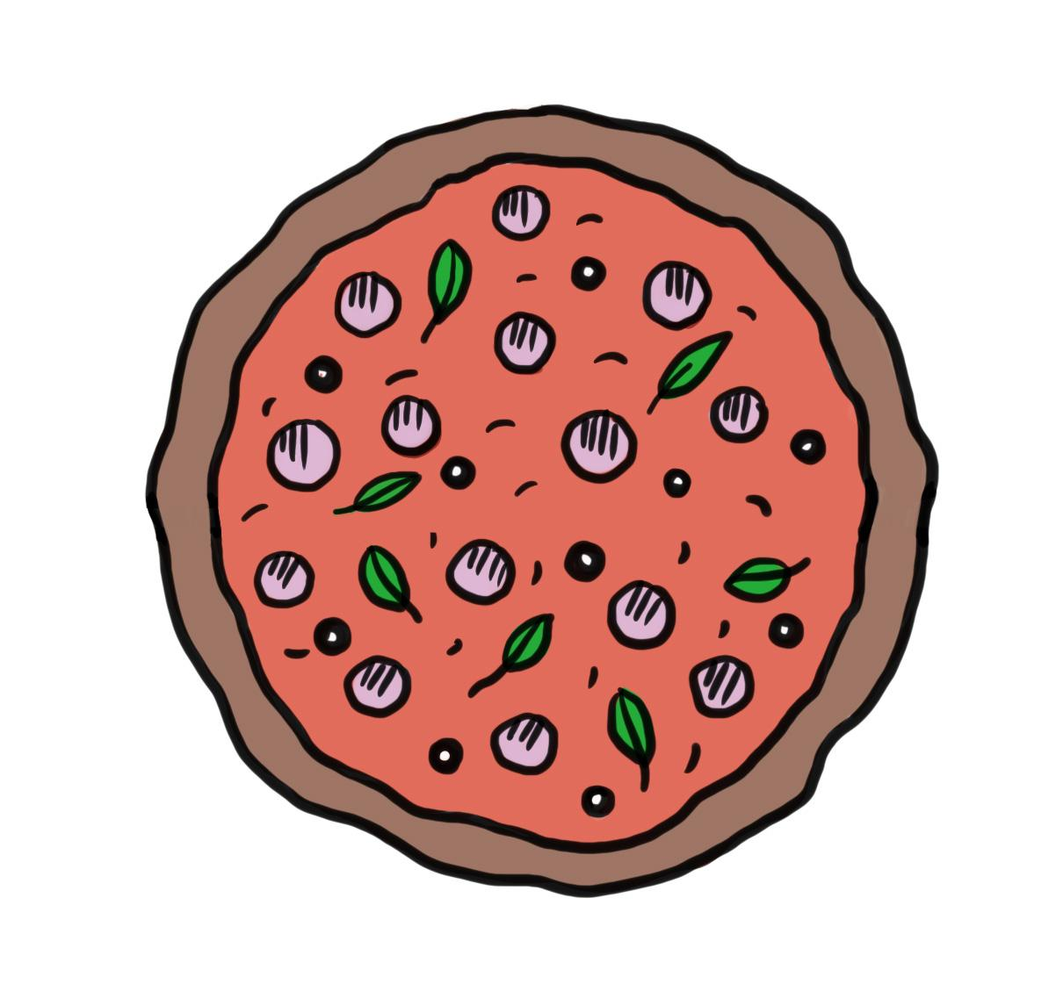

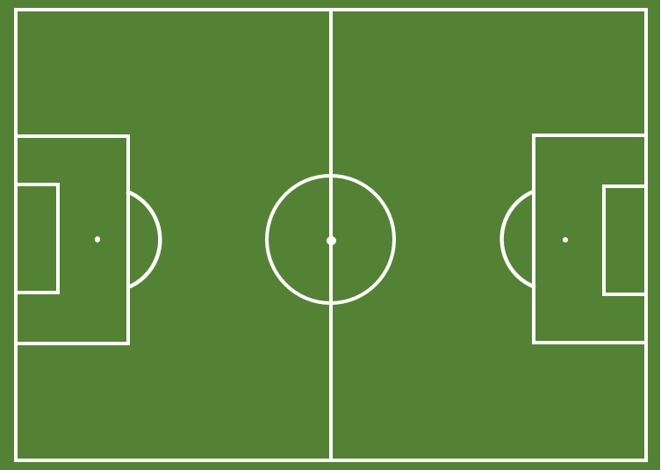
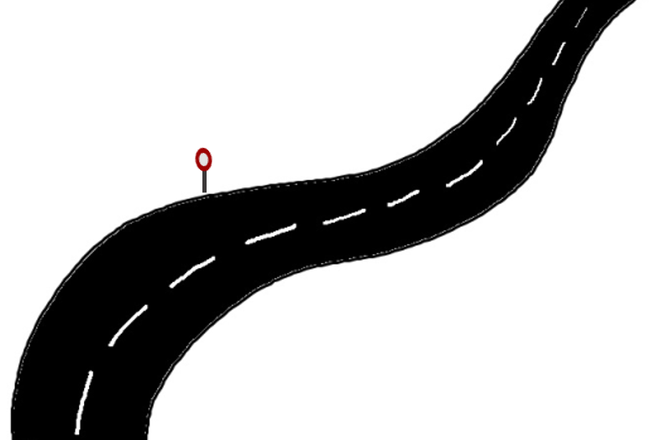
Understanding imperial units
Imperial measures come from an older system for measuring.
Examples of imperial measurements for lengths:
inches
feet
yards
miles
size of a pizza
height of a person
length of a sports field
distance of a journey

Slide 7
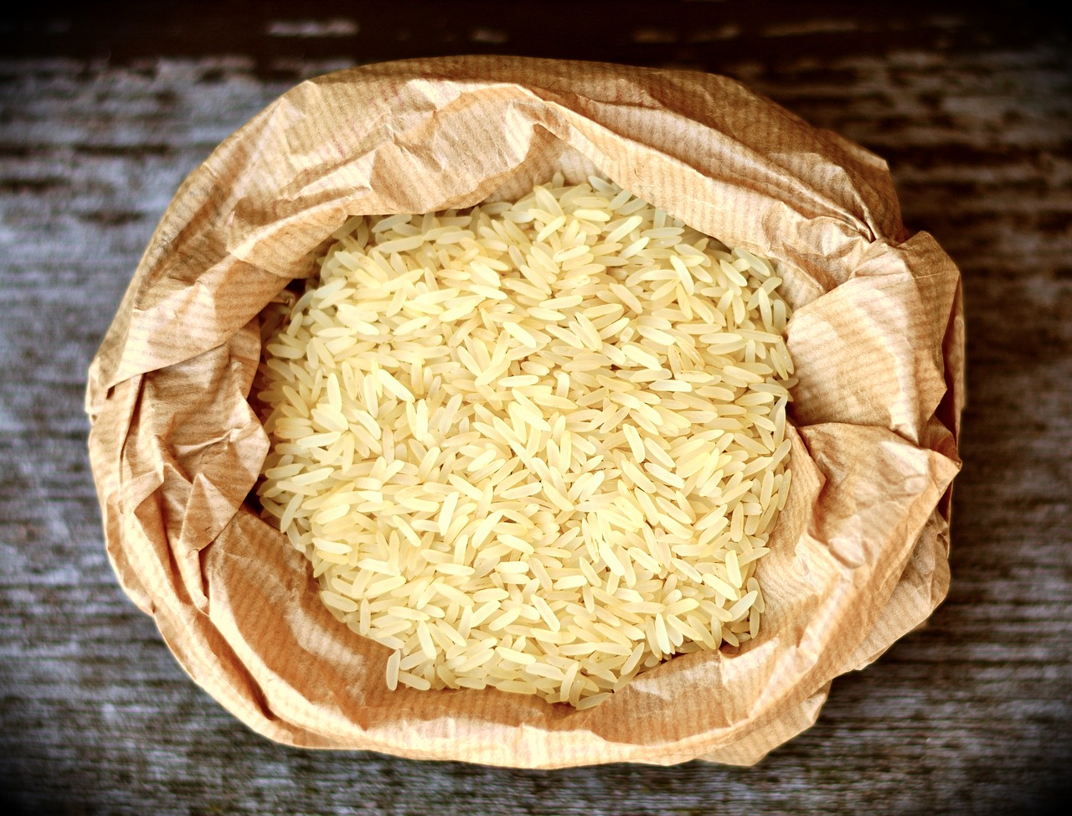


Understanding imperial units
Imperial measures come from an older system for measuring.
Examples of imperial measurements for mass:
ounces
pounds
stone
weighing ingredients
weighing a baby
weighing a child or adult

Slide 8
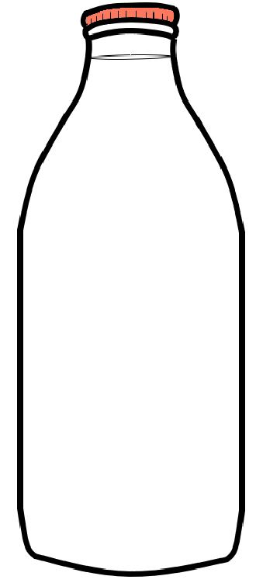
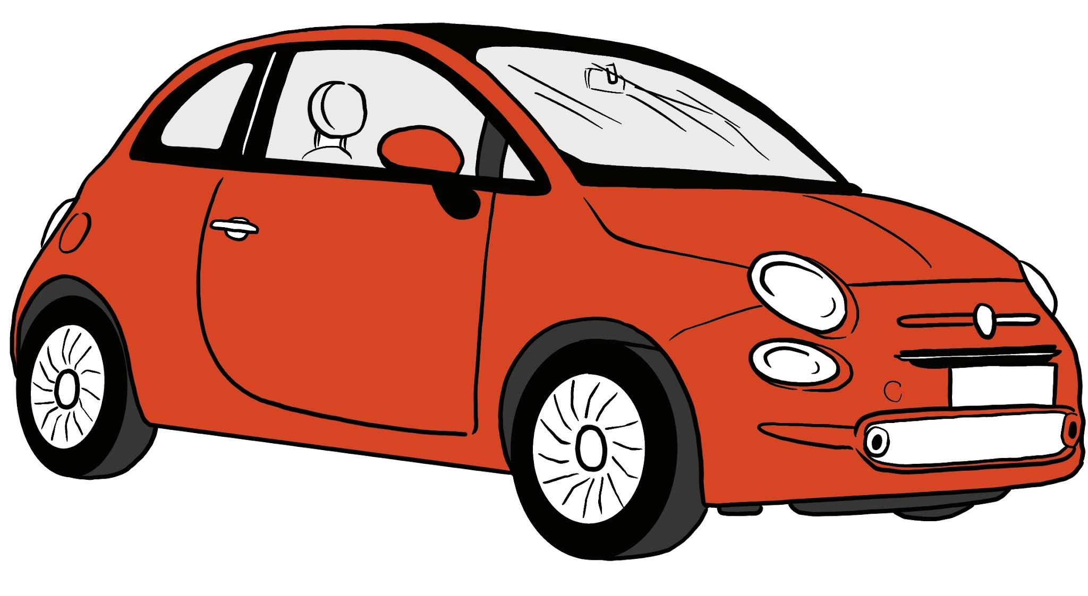
Understanding imperial units
Imperial measures come from an older system for measuring.
Examples of imperial measurements for capacity:
pints
gallons
amount of milk in a bottle
amount of petrol in a car

Slide 9

Understanding imperial units
Which can be measured in miles?
length
mass
capacity

Slide 10
Understanding imperial units
Which can be measured in pints?
length
mass
capacity

Slide 11
Understanding imperial units
Which can be measured in pounds?
amount of space inside a large box
height of a milk bottle
weight of a cat

Slide 12
Understanding imperial units
Which can be measured in gallons?
amount of space inside a large box
height of a milk bottle
weight of a cat

Slide 13
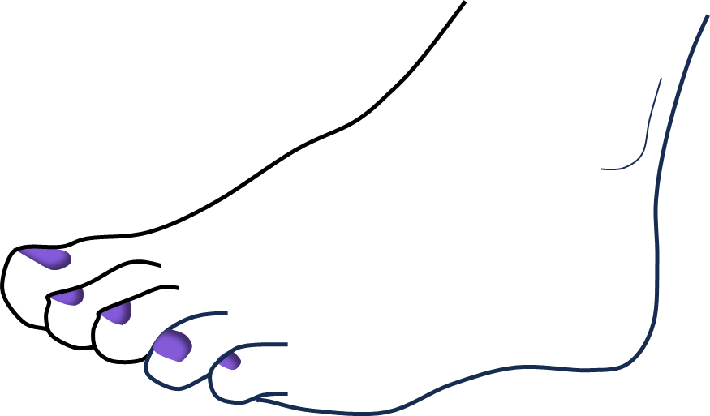
Understanding imperial units
Many units were originally based on practical ways to measure things by comparing them to objects.
For example, the unit feet was originally based on the length of a human foot. However, people have different sized feet!
During the 1800s, many of these units were standardised to create the imperial system of measurements.
For example, 1 foot is equal to exactly 12 inches.

Slide 14
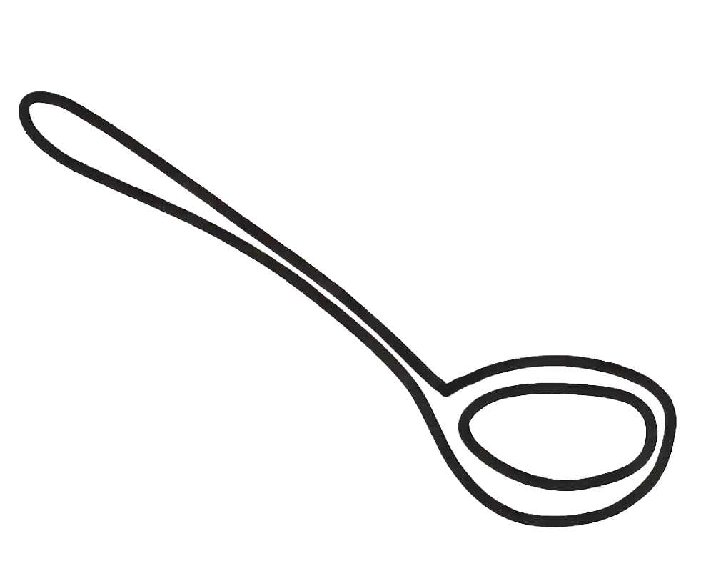
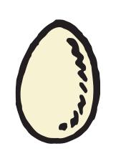
Understanding imperial units
Most countries in the world use metric units.
The USA use imperial units.
The UK uses both metric and imperial units, depending on the context.
running a 50 metre race
driving 5 miles to school

Slide 15
Understanding imperial units
Imperial units do not use the ‘kilo’, ‘centi’ or ‘milli’ prefixes, like metric units do.
Examples:
metric units of length: kilometres, centimetres, millimetres
imperial units of length: miles, yards, feet, inches

Slide 16
Understanding imperial units
Which is an imperial unit of length?
centimetres
inches
millimetres

Slide 17
Understanding imperial units
Which is an imperial unit of mass?
kilograms
grams
pounds

Slide 18
Understanding imperial units
Which is an imperial unit of capacity?
pints
litres
millilitres

Slide 19
Understanding imperial units
1) Sort the units into the correct columns.
metric | imperial
metres
miles
millilitres
centimetres
acres
tons
inches
kilograms
feet
hands
kilowatts
metric tonnes

Slide 20
Understanding imperial units
2) Sort the imperial units according to what they measure.
inches
stone
gallons
feet
pounds
pints
yards
ounces
miles
fluid ounces
length | mass | capacity

Slide 21
Understanding imperial units
1) Sort the units into the correct columns.
metric | imperial
metres | inches
kilograms | miles
millilitres | feet
centimetres | hands
kilowatts | acres
metric tonnes | tons

Slide 22
Understanding imperial units
2) Sort the imperial units according to what they measure.
length | mass | capacity
inches | ounces | fluid ounces
yards | pounds | pints
feet | stone | gallons
miles

Slide 23
Place value in imperial units
Understanding imperial units
Converting between imperial units

Slide 24
Converting between imperial units
Imperial measures use different multipliers to convert between different units.
This is unlike the metric system, where we convert between units by multiplying or dividing by 10, 100 or 1000.
It is more like when we convert between different units of time (although units of time are not imperial).
× 7
× 24
× 60
× 60
weeks | days | hours | minutes | seconds

Slide 25
Converting between imperial units
Imperial measures use different multipliers to convert between different units.
Example:
Convert 5 feet to inches.
× 1760
× 3
× 12
miles | yards | feet | inches
5
60
5
× 12
= 60
÷ 1760
÷ 3
÷ 12
5 feet = 60 inches

Slide 26
Converting between imperial units
Imperial measures use different multipliers to convert between different units.
Example:
Convert 140 pounds to stone.
× 14
× 16
stone | pounds | ounces
10
140
140
÷ 14
= 10
÷ 14
÷ 16
140 pounds = 10 stone

Slide 27
Converting between imperial units
Select the smallest unit of length.
1 yard
× 1760
× 3
× 12
miles | yards | feet | inches
1 foot
÷ 1760
÷ 3
÷ 12
1 inch
1 mile

Slide 28
Converting between imperial units
Convert 1 mile into yards.
× 1760
× 3
× 12
100 yards
miles | yards | feet | inches
1000 yards
÷ 1760
÷ 3
÷ 12
1760 yards

Slide 29
Converting between imperial units
Convert 6 yards to feet.
2 feet
× 1760
× 3
× 12
miles | yards | feet | inches
18 feet
÷ 1760
÷ 3
÷ 12
48 feet
600 feet

Slide 30
Converting between imperial units
Convert 6 feet to yards.
0.06 yards
× 1760
× 3
× 12
miles | yards | feet | inches
2 yards
÷ 1760
÷ 3
÷ 12
18 yards
48 yards

Slide 31

Converting between imperial units
1) Starting with the smallest, sort the imperial units in ascending order of size.
yards miles inches feet
2) Fill in the missing words.
Jacob is nearly six tall. He travels to school by getting the bus for five and then walking thirty .
yards miles inches feet

Slide 32
Converting between imperial units
3) Use the information given to calculate the conversions.
× 3
× 12
5 yards = feet
12 feet = yards
2 stone = pounds
160 ounces = pounds
2 yards = inches
3 yards and 1 foot = inches
240 inches = yards and feet
yards | feet | inches
÷ 3
÷ 12
× 14
× 16
stone | pounds | ounces
÷ 14
÷ 16

Slide 33
Converting between imperial units
1) Starting with the smallest, sort the imperial units in ascending order of size.
yards miles inches feet
inches, feet, yards, miles
2) Fill in the missing words.
Jacob is nearly six feet tall. He travels to school by getting the bus for five miles and then walking thirty yards .

Slide 34
Converting between imperial units
3) Use the information given to calculate the conversions.
× 3
× 12
5 yards = 15 feet
12 feet = 4 yards
2 stone = 28 pounds
160 ounces = 10 pounds
2 yards = 72 inches
3 yards and 1 foot = 120 inches
240 inches = 6 yards and 2 feet
yards | feet | inches
÷ 3
÷ 12
× 14
× 16
stone | pounds | ounces
÷ 14
÷ 16

Slide 35
Place value in imperial units
Imperial units come from an older system of measuring.
Imperial measures evolved over the course of history and were standardised during the British Empire.
People in the UK tend to use a combination of metric and imperial measures, depending on context.
Conversions between different imperial units are different to the metric system and use a greater range of numbers.

Slide 36

© Oak National Academy 2023.
Produced in partnership with Mathematics in Education and Industry.
Licensed on the Open Government Licence v3.0, except where otherwise stated. See Oak terms and conditions.

